Slide 1

LT PROJECT – COMPILER
BY:
PATEL YASH H.(IT-088)
PATEL YASH P.(IT-089)

Slide 2
Y-PER: Description
The Y-PER(Your PERsonal) language is a strongly typed language with primitive data types as integer, floating point and boolean. It also supports arrays. The language supports arithmetic and boolean expressions, simple and input/output statements, declarative statements.
This prototype compiler can be extended to support:
conditional and iterative statements
modular implementation of the functionalities.
Functions can return multiple values. (The function may or may not return a value as well. )
The scope of the variables is static and the variable is visible only in the block where it is declared.

Slide 3
Lexical Structure
The reserved keywords are:
declare, program, for, start, end, module, get_value, print, use, with, parameters, true, false, takes, input, returns, AND, OR, switch, case, break, default and while.
An identifier is a sequence of letters and digits starting with a letter.
Note: The language is case sensitive.

Slide 4
Lexical Structure
The white spaces are blanks, tabs and new line characters which are used to separate the tokens.
Any number of white spaces is ignored .
A comment starts with ** and ends with **.
An integer is a sequence of digits.
Example: 234, 1,45, 90123 etc.
A floating point number can be either a sequence of digits followed by a decimal point, followed by the fraction part of it again as a continuous sequence of digits.
Example: 23.89, 908.567

Slide 5
Lexical Structure
Floating point can also be represented in mantissa exponent form:
Example, 123.2E+6, 124.2E-1, 124.2e-1 etc.
Arithmetic operators: +, -, *, /
Relational operators: <, <=, >, >=, ==, !=
Logical operators: AND , OR
Range operator: .. (dot dot)

Slide 6
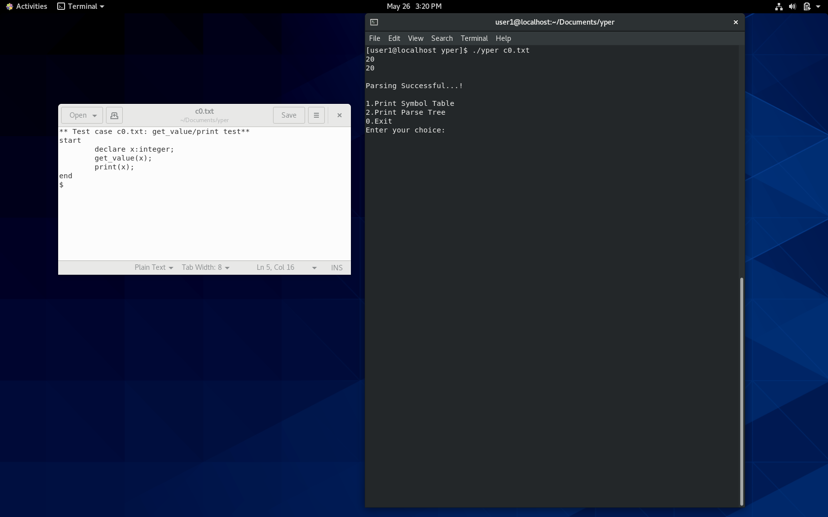
Y-PER IN ACTION

Slide 7
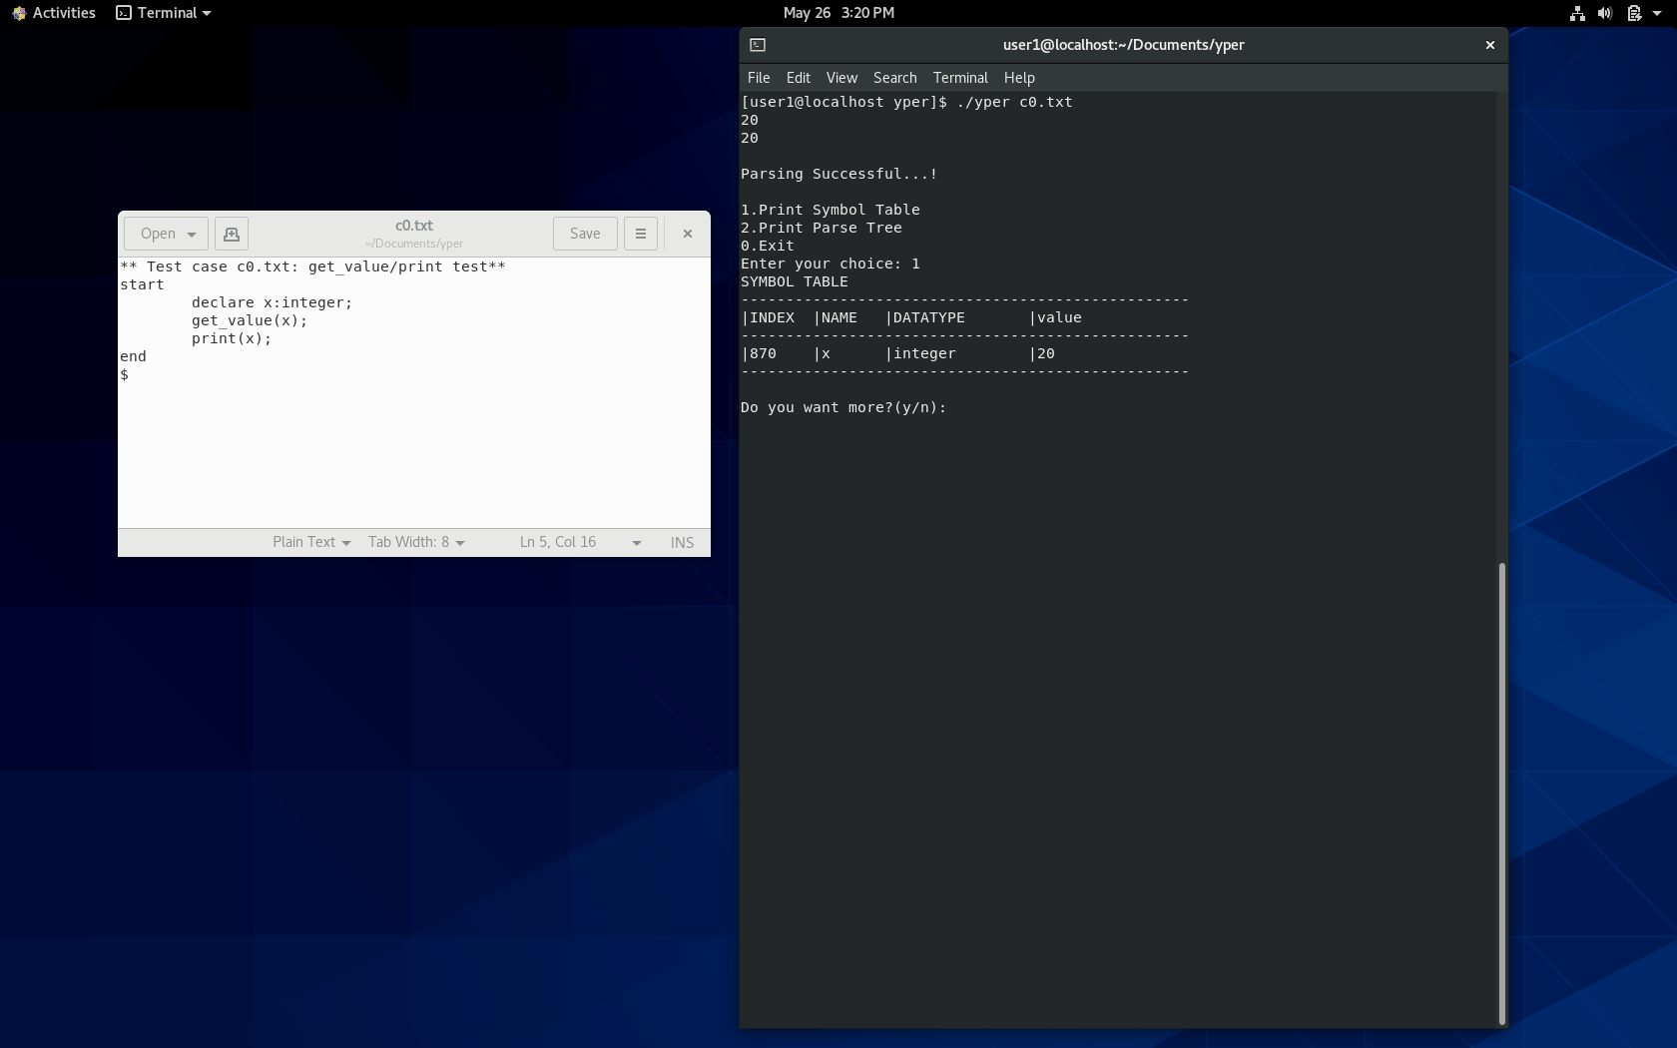
Y-PER IN ACTION

Slide 8
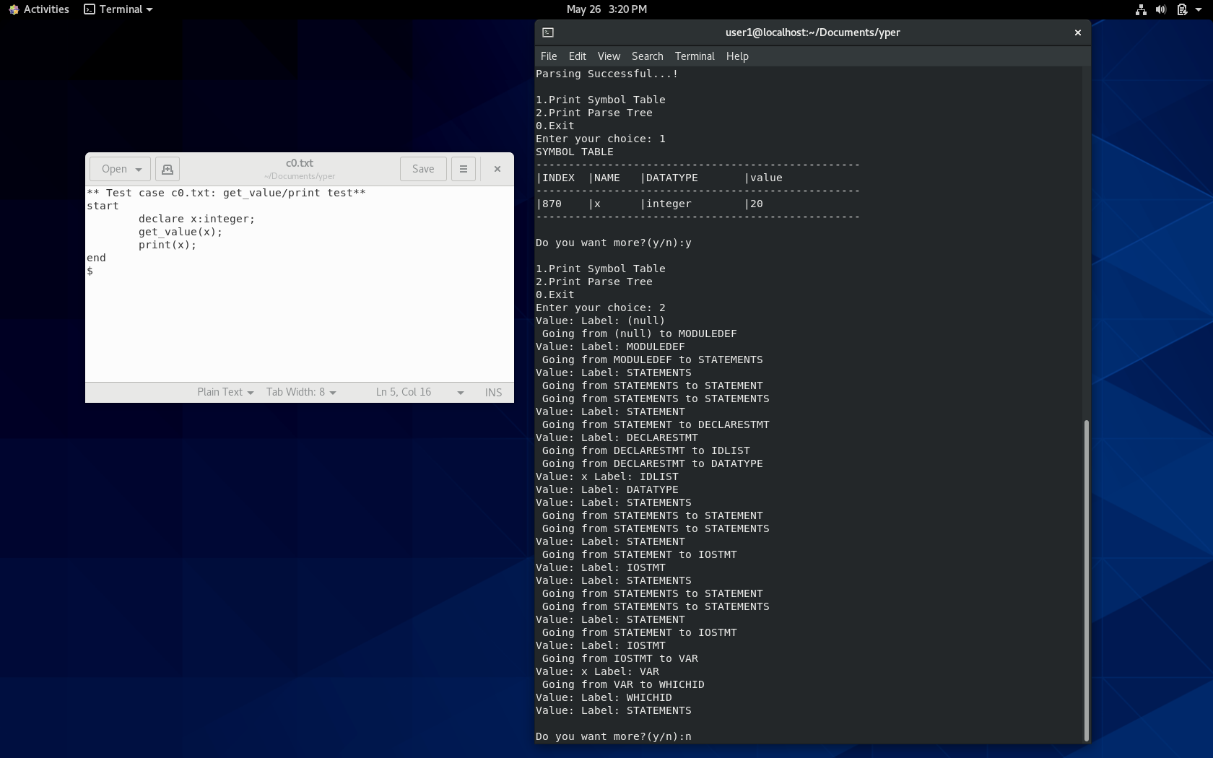
Y-PER IN ACTION

Slide 9
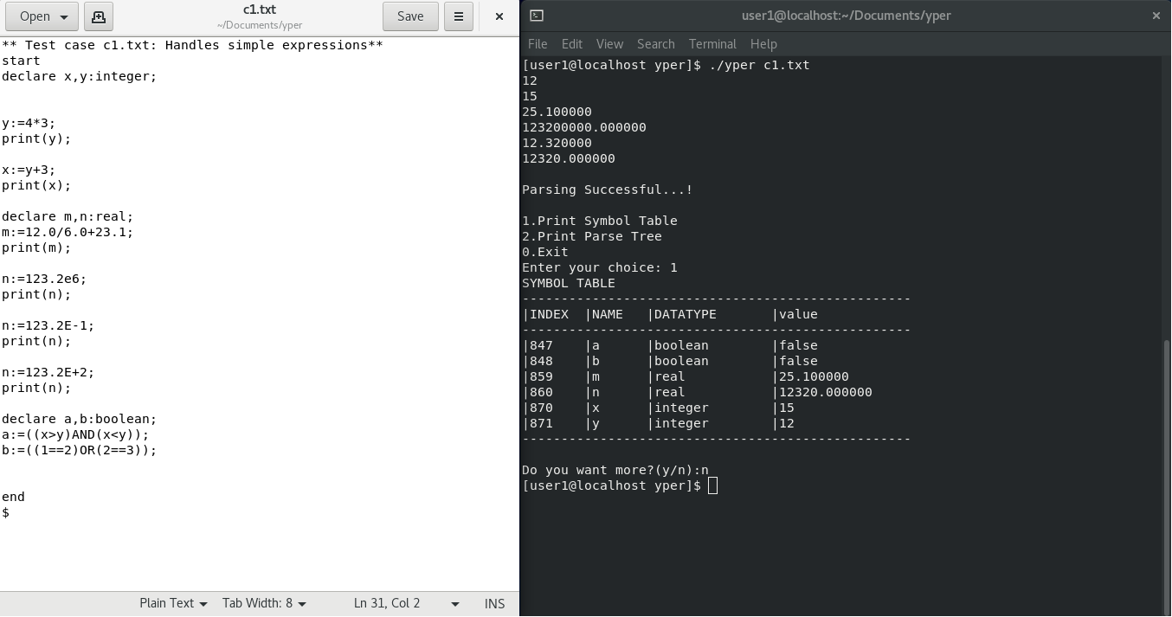
Y-PER IN ACTION

Slide 10
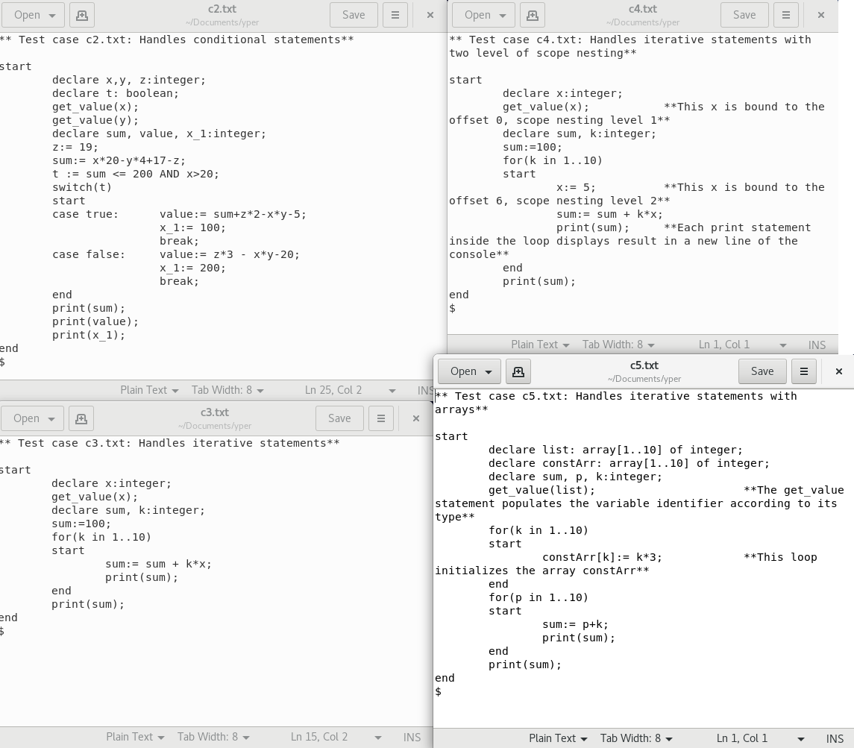
EXTENSIONS TO Y-PER

